Slide 1


Slide 2

Sustail – Sustainable retail
by Andrea, Franziska, Gina, Hadrien, Jonas, Sophie, Will und Yvonne

Slide 3
A webapp to make logistics information of online grocery shopping more transparent for customers. A platform where producers can transparently share their information on the sustainability of their transportation methods.

Slide 4
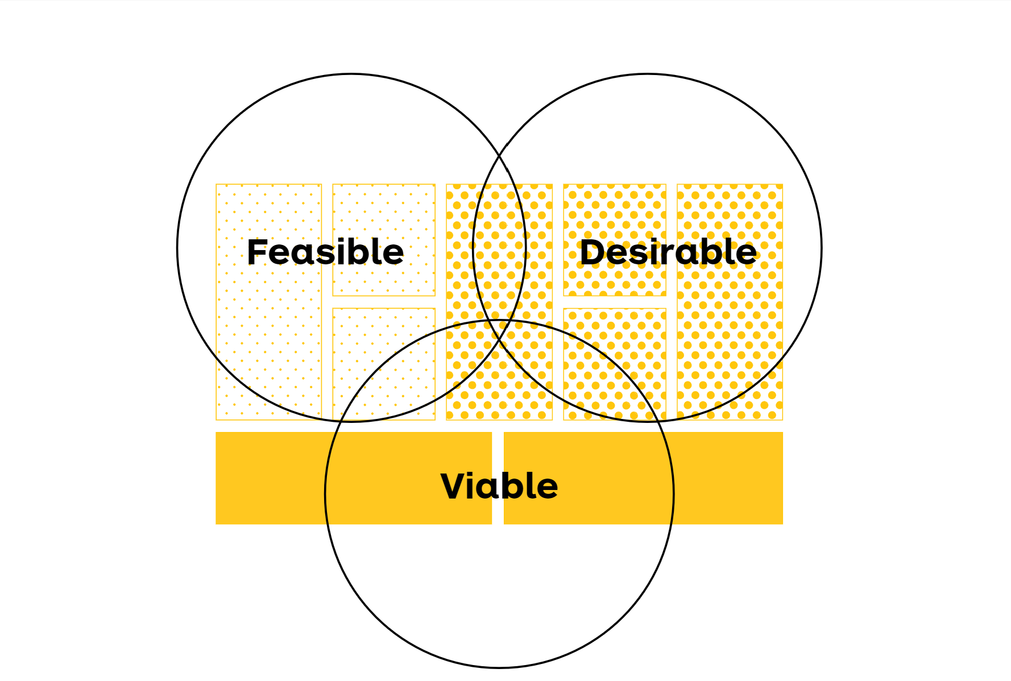
Agenda
Desirability
Personas - Hadrien
User research – Hadrien & Yvonne
Looked into articles (farmers)
Looked into statistics (users)
Questionnaire: does sustainability information make a difference
Channels - Yvonne
Feasibility
Show Time: Sustainability score vs. points for gamification - Franzi
Algorithm – Franzi
Release state of Sustail - Franzi
Tech Stack - Jonas
Scalability: could it be SaaS for a lot of people quick - Jonas
User acceptance tests: quick notes on feedback - Jonas
Viability
Business Model Canvas: USP, Virtual store runs – Will & Sophie
How to make money (Business Case Calculation) - Sophie
Our journey - Andrea
Milestones
Challenges
About Future - Gina

Slide 5
Agenda
Desirability
Personas
User research
Channels
Feasibility
Show Time
Algorithm
Release state of Sustail
Tech Stack
User acceptance tests
Viability
Business Model Canvas
Business Case Calculation
Our journey
Milestones
Challenges
About Future

Slide 6
Desirability

Slide 7


Our Personas
I. Consumers
Justus
25 years old
Economics Student
What is he looking for when shopping?
Quick and easy ways to compare products' sustainability criteria
More infos:
Busy student
Feels guitly for his unsustainable shopping habits
Limited budget
In touch with internet communities supporting sustainability
Frida
31 years old
Blogger
What is she looking for when shopping?
Easily collect new content for her blog by comparing products to test and create new recipes
More infos:
Wants to share sustainable recipes
Wants to reach people sensitive to sustainability

Slide 8
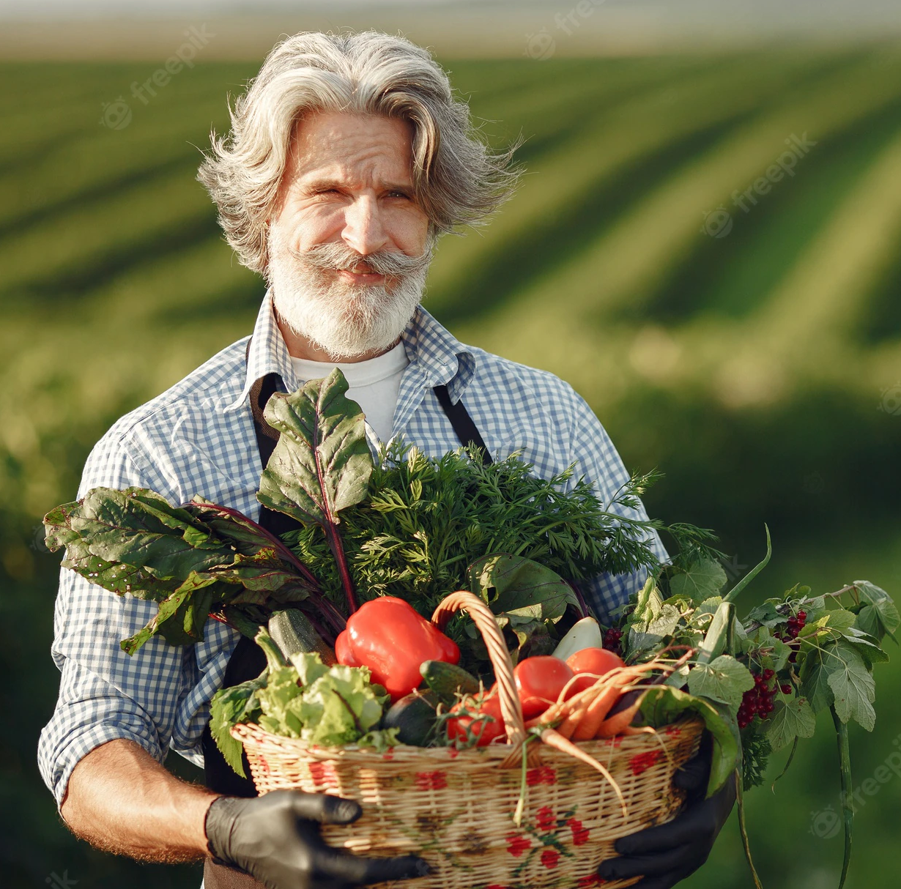
Our Personas
I. Goods suppliers (Farmers)
Paul
56 years old
Farmer
What is he looking for when selling his products?
An easy and direct way to reach new customers on a sustainable platform
More infos :
Wants to be able to sell more sustainable products
Do not want to make marketing
Do not want to create and run a web page

Slide 9
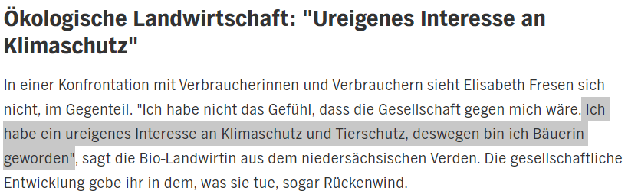
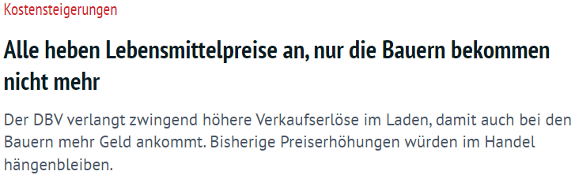
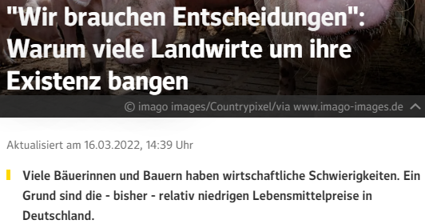
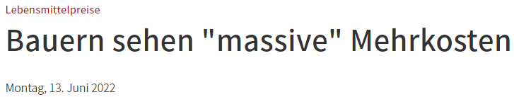
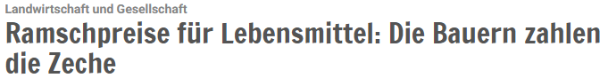
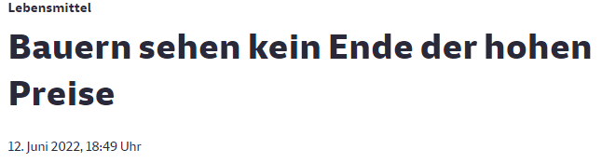
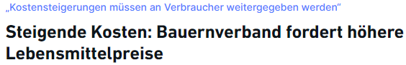
Need for producers
Weil die Preise auf dem großen Markt schlecht sind, hat sie vor Kurzem auf Direktvermarktung umgestellt. Sie ist überrascht, wie gut der Verkauf im eigenen Hofladen läuft: "Das zeigt mir: Die Leute wollen gutes Fleisch, obwohl sie bei mir viel höhere Preise zahlen als im Lebensmitteleinzelhandel."
Notes:
Edeka and other retail stores pressure farmers to reduce their prices

Slide 10
Insights about farmers
Regarding global market :
Bad prices on the global market
Farmers have to face extra costs and price increase
Out of 1€, farmers only get 23 cents
Regarding direct market :
More & more farmers are switching to direct market
Consumers are reaching the farm stores
Farmers are confident about the will of people to buy sustainable
Notes:
Edeka and other retail stores pressure farmers to reduce their prices

Slide 11
Desirability-User need
https://de.statista.com/statistik/studie/id/108408/dokument/lebensmittelverpackungen/

Slide 12
Do you pay attention to the packaging of the products you want to buy?
Survey on the importance of the type of packaging when buying food in Germany 2021
48
Beschreibung: Eine Umfrage von POSpulse zeigt, dass rund 34 Prozent der Befragten beim Lebensmitteleinkauf versuchen würden, auf Plastikverpackungen zu verzichten. Knapp 18 Prozent der Umfrage-Teilnehmer in Deutschland hingegen gaben an, nicht auf die Verpackung von Lebensmitteln beim Einkauf Acht zu geben. Mehr
Hinweis(e): Deutschland; 26.03.2021 bis 29.04.2021; 2.511 Befragte
Quelle(n): POSpulse
Notes:
Description: A survey by POS pulse shows that around 74 percent of respondents would try to avoid plastic packaging or too many packaging when shopping for food. In contrast, just under 18 percent of survey participants in Germany said they do not pay attention to food packaging when shopping.

Slide 13
How important are the following characteristics of food packaging to you?
Survey on the relevant properties of food packaging 2020
Anteil der Befragten
49
Beschreibung: Für die Mehrheit der Verbraucher in Deutschland ist es wichtig, dass für Lebensmittel nachhaltige Verpackungsmaterialien verwendet werden. Rund 78 Prozent der Befragten einer Umfrage aus dem Januar 2020 gaben an, dass ihnen dies sehr wichtig wäre. Von zweithöchster Relevanz ist die Bereitstellung von Produktinformationen auf Verpackungen. Mehr
Hinweis(e): Deutschland; Januar 2020; 1.241 Befragte
Quelle(n): ifeu; IÖW
Notes:
Description: For the majority of consumers in Germany, it is important that sustainable packaging materials are used for food. Around 78 percent of respondents to a survey conducted in January 2020 said this was very important to them. Of second highest relevance is the provision of product information on packaging.

Slide 14
To what extent does the packaging material influence your purchase decision?
Survey on the influence of packaging material on purchasing decisions in 2021
Anteil der Befragten
52
Beschreibung: Rund 30,02 Prozent der Befragten gaben im Jahr 2021 an, Produkte eher zu kaufen, wenn sie in Pappe oder Papier verpackt sind. Mit einem Anteil von 27,02 Prozent kauften auch viele Verbraucher Produkte bevorzugt im unverpackten Zustand. Dies ergab eine in Deutschland durchgeführte POSpulse-Umfrage. Mehr
Hinweis(e): Deutschland; 27.07.2021 bis 16.08.2021; 866 Befragte
Quelle(n): POSpulse
Notes:
Description: Around 30.02 percent of respondents in 2021 said they were more likely to buy products if they were packaged in cardboard or paper. With a share of 27.02 percent, many consumers also preferred to buy products in an unpackaged state.

Slide 15
To what extent do you agree with the following statement? "I am willing to pay more for products whose packaging is particularly environmentally friendly."
Survey on willingness to spend on environmentally friendly packaging by country 2021
Anteil der Befragten
65
Beschreibung: Laut einer europaweiten YouGov-Umfrage aus dem Jahr 2021 wären insbesondere die Verbraucher in Italien dazu bereit, mehr für Produkte zu bezahlen, deren Verpackung umweltfreundlich ist. Rund 65 Prozent der Befragten gaben dies dort an. In Deutschland lag der Anteil bei knapp der Hälfte der Befragten. Mehr
Hinweis(e): Europa; 26. Januar bis 12. Februar 2021; 10.471¹; ab 18 Jahre
Quelle(n): YouGov
Notes:
Nearly half or more than half consumers would be willing to pay more for products whose packaging is environmentally friendly.

Slide 16

Customers are willing to pay more for sustainable products.
Avg. Increase of 58%

Slide 17
Virtual store runs

Slide 18


Slide 19
Desirability
Producers need to
Customer is willing to pay more to buy
Improve the quality of products
Be more sustainable
High quality products
Green products with less package & lower footprint
Competitors don´t provide (enough) information on sustainability
Sustail – Sustainable retail

Slide 20









Desirability – Channels
Social media Influencers Social Media Ads
On farms
Website/App Emails
Notes:
Channels describe how your company communicates with and reaches your Customer Segments to deliver your Value Proposition.
The farmers that sell products on our page could place banners like that on their farm with advertisements for Sustail. So potential customers see them
Google Ads
Youtube Ads
Instagram Ads
TikTok Ads
Social media Influencers
Janka kennst du vielleicht aus dem TV:
2017 hat sie in der TV-Show "Küchenschlacht" mitgemacht und Mario Kotaska und anderen Sterneköchen gezeigt, wie man richtig kocht.
Heute ist Janka Fotografin und Blogger auf ihrem Foodblog und verwöhnt dich mit leckeren und kreativen Rezepten.

Slide 21
Feasibility

Slide 22
Show Time
Feasibility

Slide 23

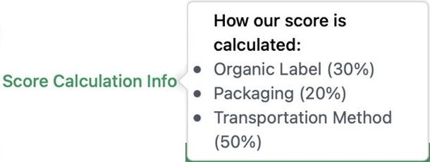
Feasibility – Algorithm
Organic:
0 if false
18 if true
Packaging:
Points between 1 – 12
Transportation Method:
15 if electric / 0 if gasoline
15 if grouped / 0 if single
Max Points per Product: 60

Slide 24

Feasibility – Release state of Sustail
Farmers on board
Comparison and recommendation of products
Gamification
Calculate score for rankings and user level
Share Score, achievements & badges on instagram
Recipes

Slide 25
Feasibility – Release state of Sustail
Changes like:
Implement categorical filtering
More Information on product detail page
Only show the producer's products for editting
Another page after the sign in and no more registering
Implementing payment
Minor technical fixes

Slide 26
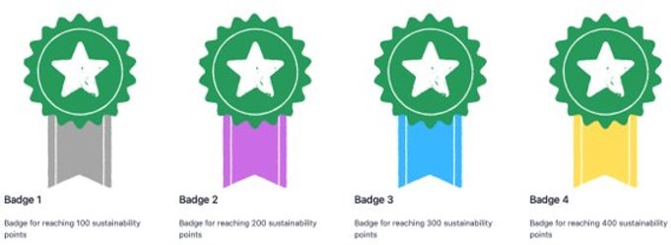

Gamification
Achievements & Badges
Score
Calculated based on sustainability scores of products
Rankings and different levels of customers
Scores and achievements can be shared on Instagram!

Slide 27

Feasibility Recipes
Recommendations based on
Products in cart
Community's most favourite
Seasonal and past recipes
Predefined allerges etc.
Community based
Everyone can provide, rate and share recipes

Slide 28





Feasibility – Tech Stack
Frontend
Server Side Rendering
Modular
State of the art technology
Backend
Fast
Minimal and flexible
Robust
MongoDB Atlas
Deployment
Platform independent
Scalability
Hyperscaler
IaaS
Ressources on demand
Notes:
Also answering if we could scale as a SaaS when we have 800000 users tomorrow

Slide 29
Feasibility – User acceptance test
Some details discovered that need to be implemented
When product added to cart: popup with: "go to checkout or continue shopping"
Delivery time interesting for comparison of products
Information in order confirmation page: "delivery status can be checked in profile. We will also send you the tracking link via email"

Slide 30
Viability

Slide 31
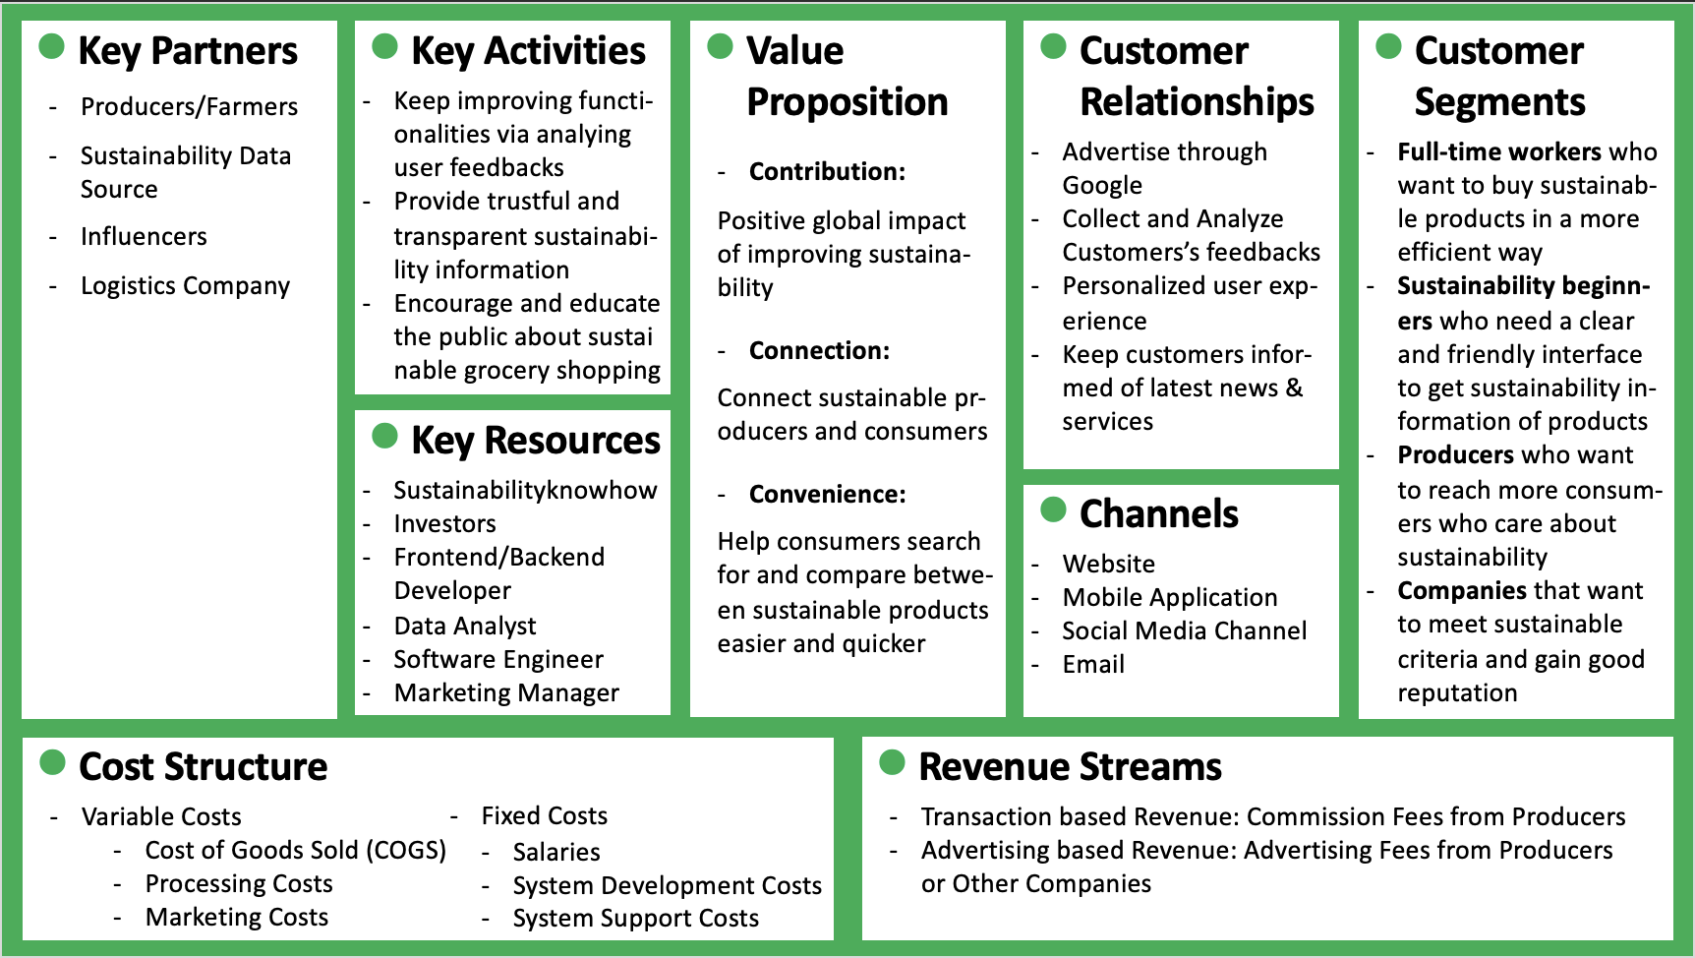

Slide 35
Viability - Market Size & Potential Audience
In 2021, there are about
Potential Audience
6.6 M
8.34 M
People aged between 16 and 45 years have bought groceries online.
8.34 M x 80% =
And over
of people are willing to
pay more money for sustainable products.
Estimated Traffics
0.66 M
80%
10% of Potential Audience

Slide 36
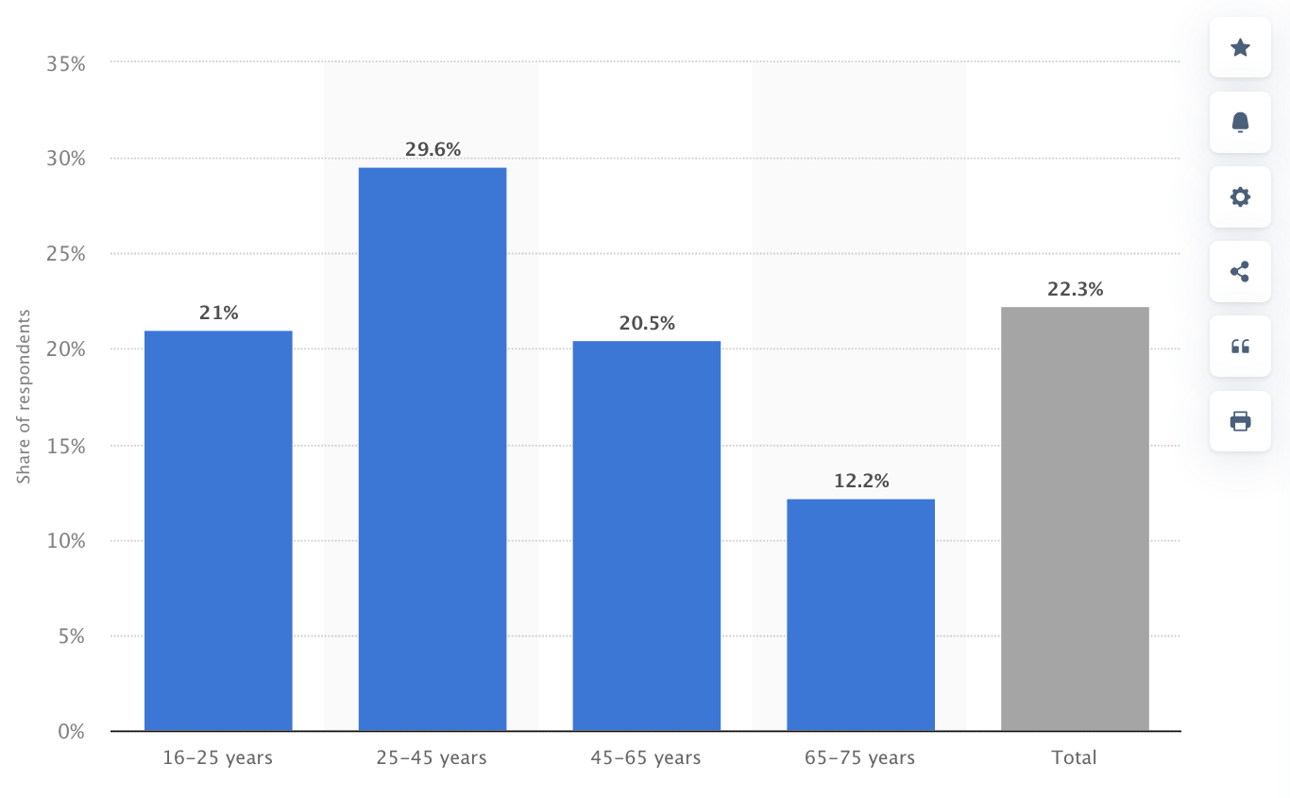
Appendix – Potential Audience
Share of online shoppers who ordered or purchased groceries/essential goods for private purposes on the internet in Germany in 2021, by age group
 | Share of online shoppers buying groceries online | Population (Million) | Number of Potential Audience (Million)
16-25 years | 21% | 8.6 | 1.806*0.8 = 1.4
25-45 years | 29.6% | 22.1 | 6.5416*0.8 = 5.2
Total Number of Potential Audience |  |  | 6.6 M
** According to survey, over 80 percent of people are willing to pay more money for sustainable packaging.
Region: Germany
Survey time period: March 1 to July 31, 2021
Age group: 16-75 years
Method of interview: Questionnaire
Source: Statista
Notes:
In 2021, almost 30 percent of respondents aged between 25 and 45 years stated to have bought groceries online within the last three months. Among the age group of 16-25-year-olds, 21 percent of respondents had shopped for groceries online.

Slide 37
Viability – Business Case Calculation
Year | 1 | 2 | 3
Variable Costs (COGS, Processing, Marketing) | 40,000 | 50,000 | 60,000
Fixed Costs (Salaries, System Development, System Support) | 200,000 | 180,000 | 160,000
Total Costs | 240,000 | 230,000 | 220,000
Average Order Value | 150 | 170 | 180
Number of Orders | 3000 | 4,500 | 5,500
Transaction based Revenue (Commission Rate may differ between categories) | 50,000 | 70,000 | 80,000
Advertising based Revenue | 90,000 | 300,000 | 450,000
Total Revenue | 140,000 | 370,000 | 530,000
Profit | -100,000 | 140,000 | 310,000
** Amounts are in Euro(€)

Slide 38
Our journey

Slide 39
Milestones
Sprint 1
Start of the project
Sprint 2
Initialisation of Frontend and Backend
Startpage, Product Overview and Product Page
Sprint 3
Sprint 5
Sprint 4
Mockups of the pages
User and Feasibility research
Developement of conceptual Sustainability score
Connection with Backend
More Transparency (Pop-up, About us)
Deployment of our Website
Backend objects (User Management, Orders, Users)
Checkout/After-Checkout page
Advanced Viability reseach
Building up core functions (Filtering Products, log-in/register)
Fine tuning and Evaluation
User acceptance tests
Interviews, Reviews
Personal page, Cart page
Added functions/fixes

Slide 40
Challenges
Challenges
Time Management
Communication
Information Transparency
Considering Viability, Feasibility and Desirability

Slide 41
Thinking future…

Slide 42
Thinking future…
Addressing local farmers
Getting bigger companies on board
Holistic and transparent platform for sustainable grocery shopping

Slide 43

Thinking future…
Gamification
Seasonal badges (limited)
NFTs (new market)
With every achieved batch
You earn a voucher for your next Sustail purchase OR
We make a small donation to a sustainability project

Slide 44

Thinking future…
In store solution
Cooperation with Everledger (already partner of SAP)
Scannable NFC-Tag
Blockchain based
Connection to Sustail app to get all information on the product and do comparisons
Alternatively
Barcode Scanner to compare product to apps in Sustail

Slide 45


Thinking future…
More sustainable delivery
Ecocart (already partner of SAP)
To make the order on Sustail carbon neutral

Slide 46
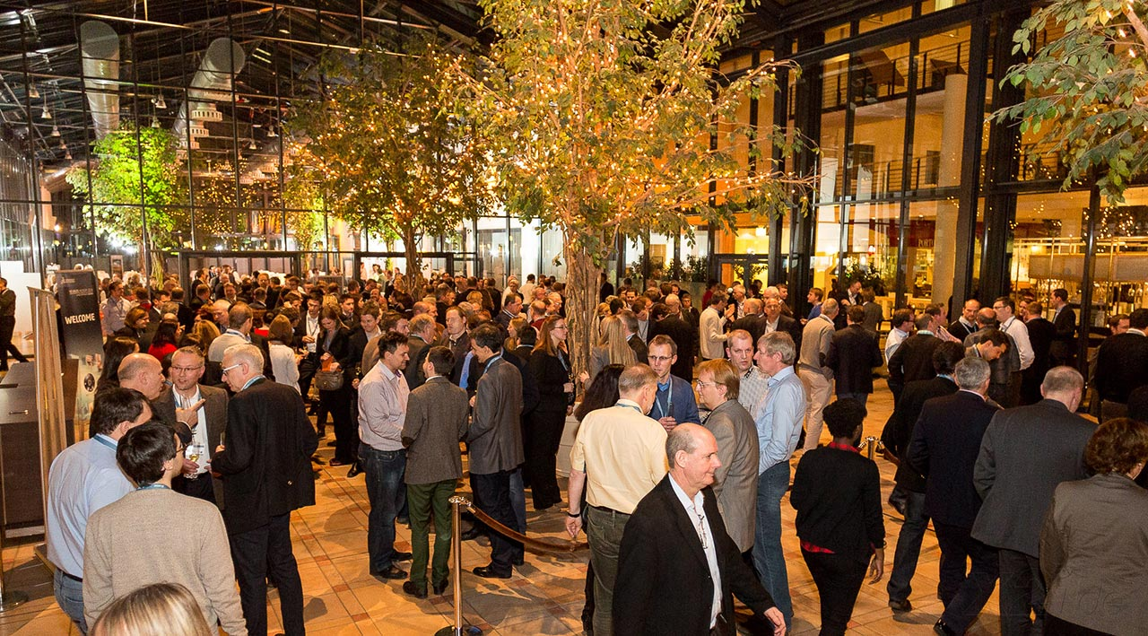

Thinking future…
Live events
With sustainability influencers
Or doing voluntary work together

Slide 47
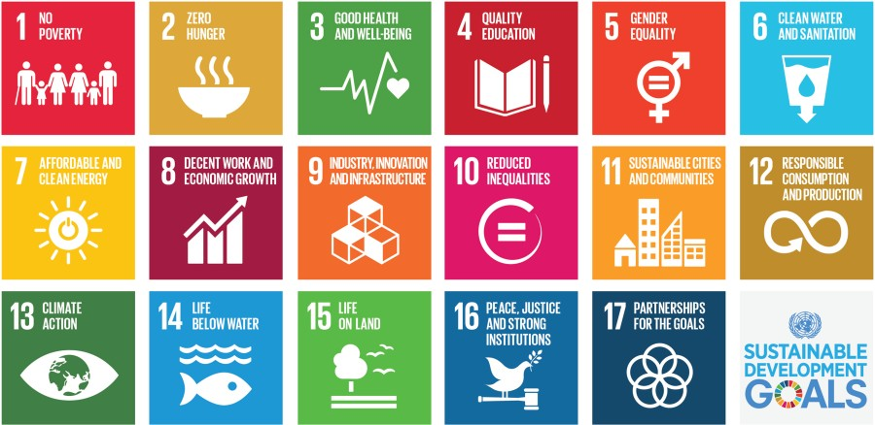
Thinking future…
Optimizing our algorithm
More aspects:
UN ESG goals
distance travelled
How cooperative the big producers are -> food waste

Slide 48

Thinking future…
Possible SAP solutions to help on our journey
SAP Commerce Cloud
E-Commerce platform that uses enterprise wide data for better UX
SAP Emarsys Customer Engagement
Omnichannel-customer-contact, e.g. personalized emails
SAP E-Mobility: for in-Store solution
When chosen sustainable vehicle to get to retail store: get voucher/discount on your next Sustail purchase
SAP Product Footprint Management
Calculate footprints of products at scale
SAP Logistics Business Network Material Traceability
Connect business partners for inter.company logistics collaboration, track and trace

Slide 49
Thank you for listening

